Slide 1
TECNICHE E RISULTATI DELLA SASI
Prof. Paolo bernante
Dimec
Alma mater studiorum universita’ di bologna
Centro di chirurgia metabolica e dell’obesità
IRCCS Policlinico di sant’orsola

Slide 2
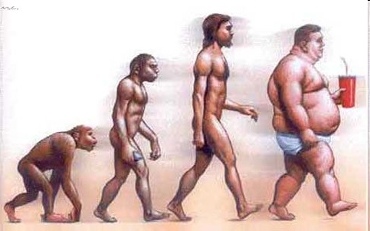
“OTTIMO PER LA CARESTIA INDIFESO DALL’ABBONDANZA”
Stomaco troppo grande?
Intestino troppo lungo?

Slide 7
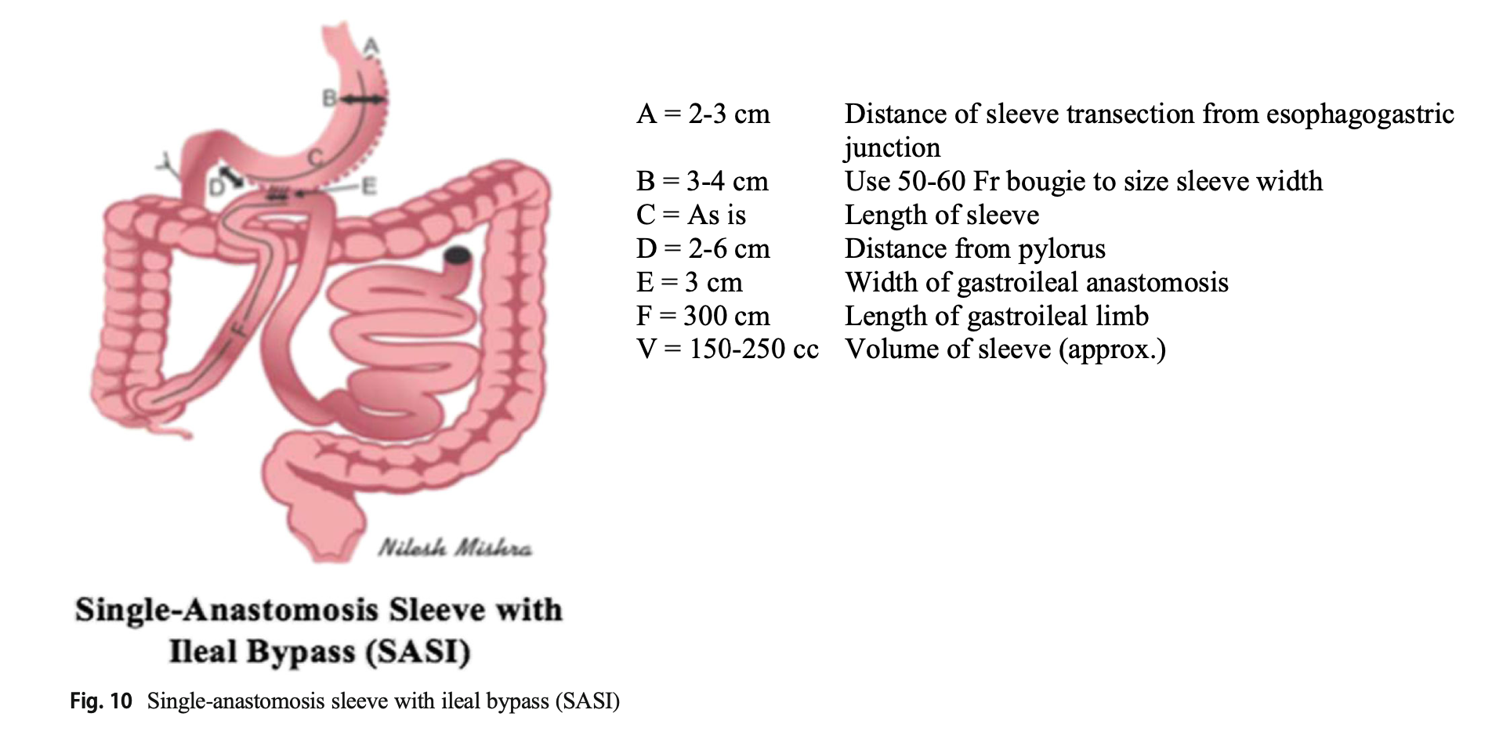
Laparoscopic sleeve gastrectomy with loop bipartition
Laparoscopic sleeve gastrectomy with loop gastroileal bypass
Laparoscopic sleeve gastrectomy with transit loop bipartition
AKA

Slide 8
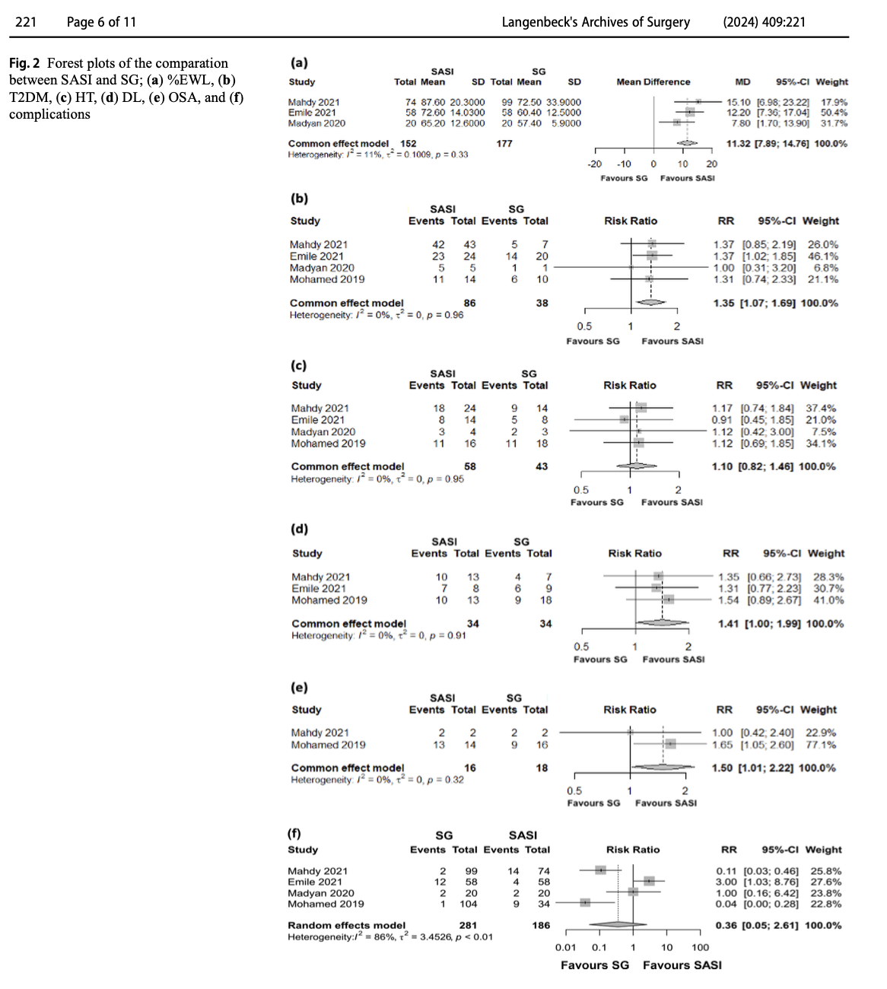
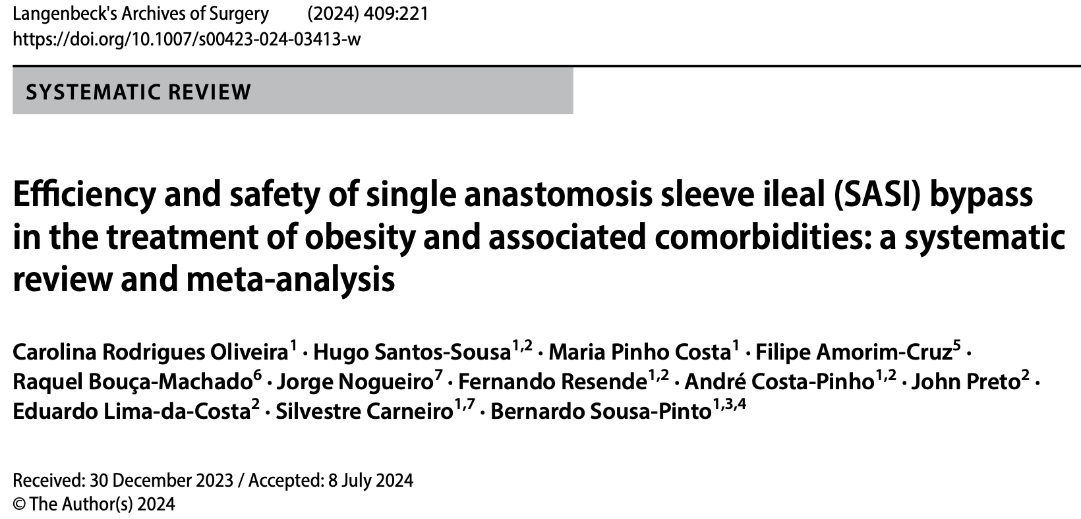
SASI vs SLEEVE
%EWL
T2DM
Hypertension
Dyslipidemia
OSAS
Complications

Slide 9
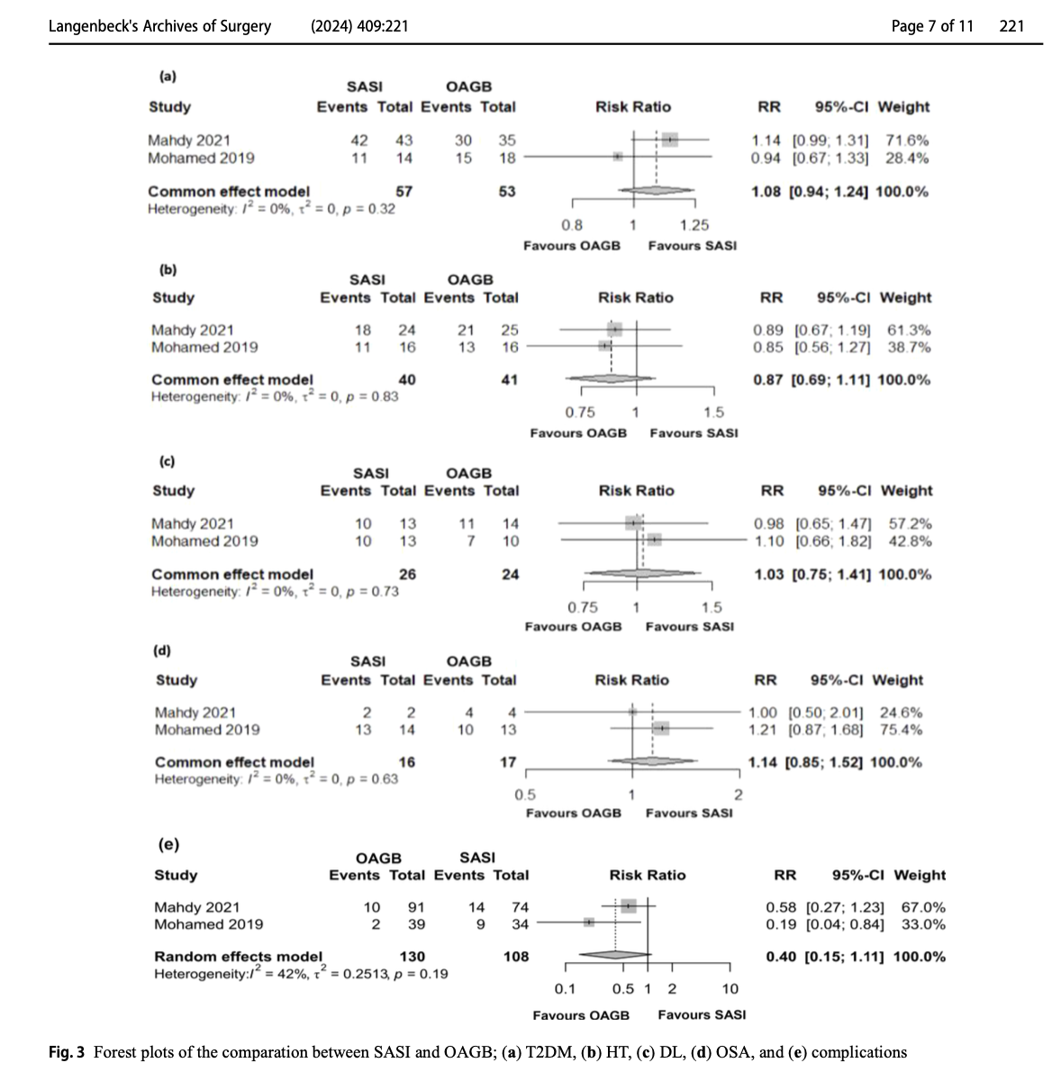
SASI vs OAGB
T2DM
Hypertension
Dyslipidemia
OSAS
Complications

Slide 10
TECHNICAL VARIATIONS AND RESULTS
Length of the common limb, which varied between 200 and 350 cm
Size of the gastro-ileal anastomosis, which was 3–4 cm
Gastro-ileal anastomosis proximal to the pylorus, which ranged
between 3 and 6 cm
A longer biliopancreatic limb was associated with greater improvement in HT
A larger anastomosis size was associated with higher weight loss and a decrease in HT due to food diversion from the gastric pouch to the ileum, leading to an increasement in the malabsorptive effect

Slide 11
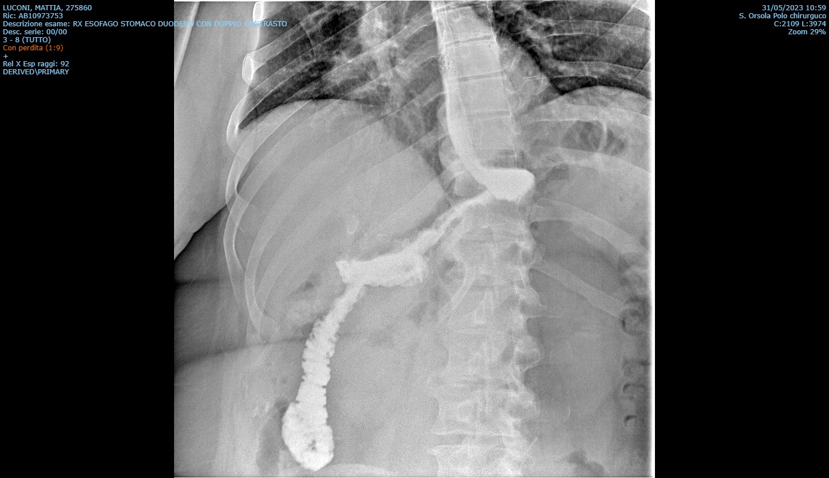
ESPERIENZA PERSONALE: CONVERSIONE DA SLEEVE A SASI
ANEDDOTICA (2 CASI)
INDICAZIONI: WEIGHT REGAIN + GASTRITE CRONICA ATROFICA CON METAPLASIA INTESTINALE

Slide 12
ESPERIENZA PERSONALE: CONVERSIONE DA SLEEVE A SASI
Caso 1
3/2015 sleeve gastrectomy | Kg 190 BMI 59,37
2016 nadir ponderale | Kg 136
5/2023 weight regain: SASI | Kg 151
5/2024 | Kg 141
Caso 2
5/2016 sleeve gastrectomy | Kg 158 BMI 57,34
4/2018 nadir ponderale | Kg 100
11/2022 weight regain: SASI | Kg 126
3/2023 | Kg 109

Slide 13
The short- and medium-term effectiveness
of SASI may be satisfactory. It may be an effective
and safe method for the treatment of obesity. SASI
may be an effective method of revisional bariatric
surgery performed for GERD. However, it had poor
outcomes in revisional bariatric surgery performed
for weight regain.

Slide 14
TAKE HOME MESSAGE
EFFICACE E SICURA COME PROCEDURA PRIMARIA (NB SLEEVE PIU’ AMPIA)
RISULTATI NON SODDISFACENTI IN TERMINI DI CALO PONDERALE COME CONVERSIONE POST-SLEEVE ??
POCHI STUDI DI CONFRONTO CON RYGB
DA STUDIARE L’INCIDENZA DELLE IPOGLICEMIE REATTIVE (LATE DUMPING) ??
PROPOSTA RACCOLTA DATI MULTICENTRICA (paolo.bernante@unibo.it)

Slide 15
Grazie

